Slide 1
PROJECT
MADE BY:
A)UJESH SISODIA
B)HITENDRA SISODIA
C)HIMANSHU SARASWAT
D)PRIYAM JAIN
GUIDED BY: Mrs. REKHA VERMA

Slide 2
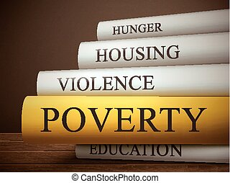
FACTS
1) 84 million people in india live on $1.25 or less.
2) 8,82,000 people die from lack of food.

Slide 3
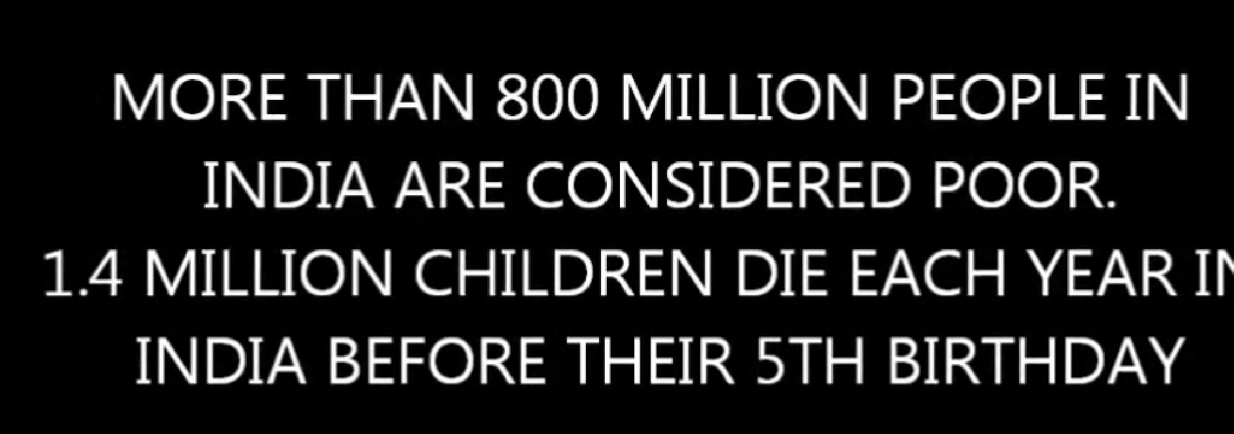

Slide 4
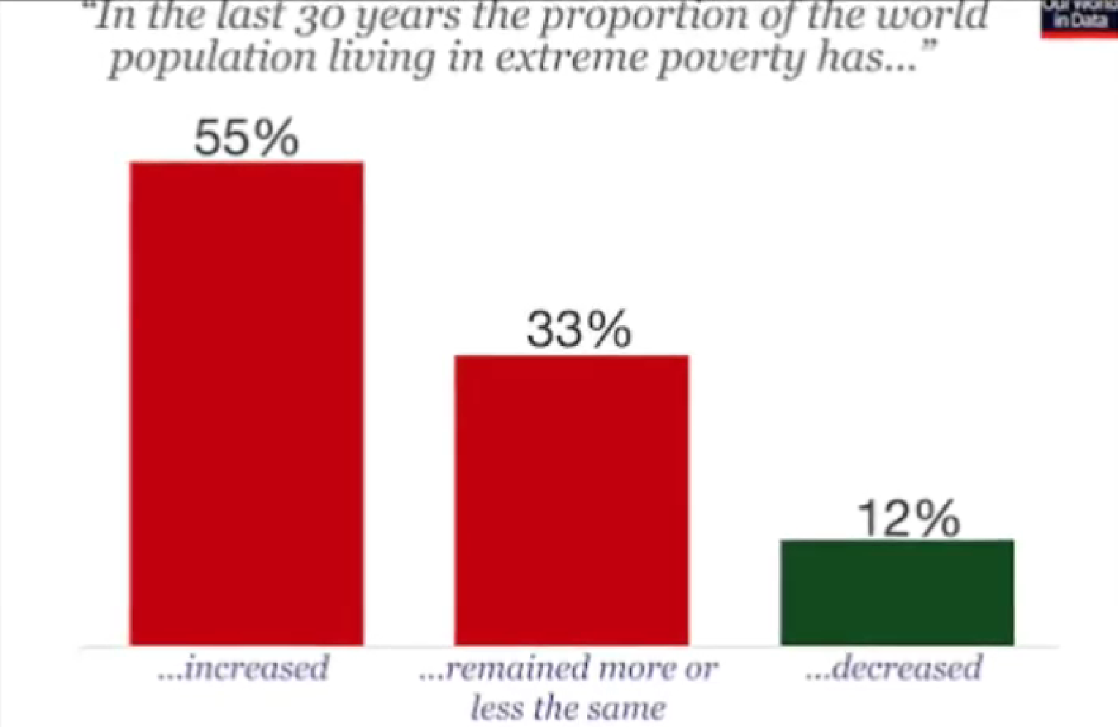

Slide 5
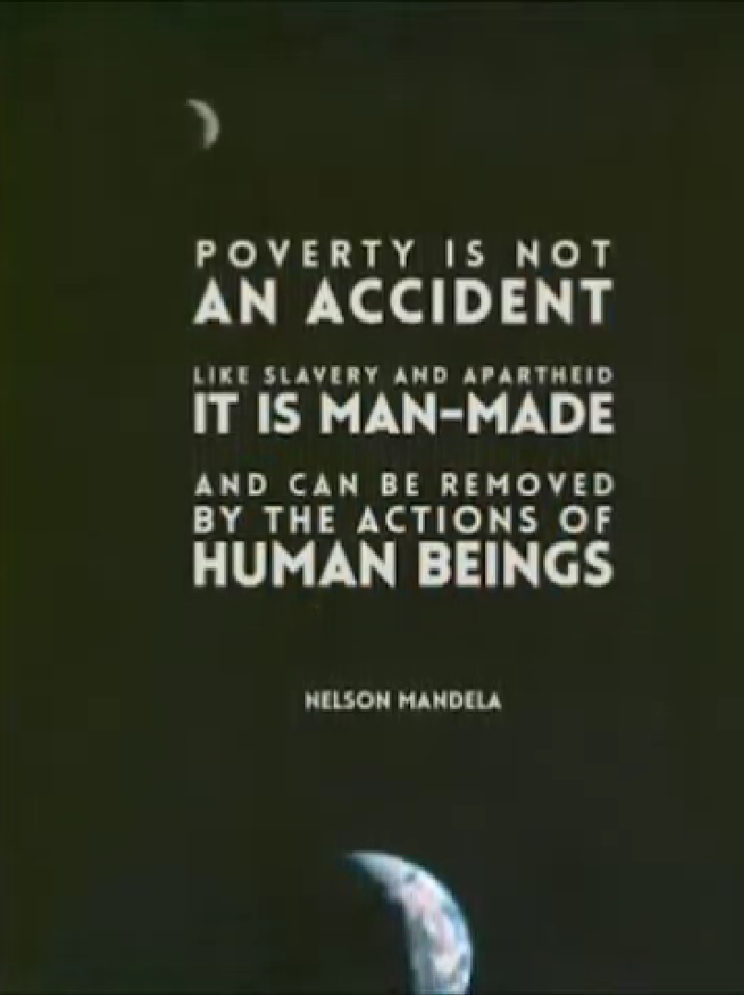

Slide 6
EFFECTS

Slide 7
Dependence
Poverty often leads to an unhealthy state of dependence.
This could mean the dependence on your parents or also the dependence on a job you hate but have to work in order to provide enough food.
Dependence is always a bad thing for the person who is dependent since these people will likely get exploited by people who have power over them.
Dependence may increase the risk for bullying and bad treatment of people.
Since poor people are more likely to become dependent, poverty can be regarded as a major cause of the dependence of people and the related adverse effects.

Slide 8
Mental issues
Mental issues
Apart from physical issues, poor people often also suffer from mental issues and social isolation.
Imagine you have children but you don’t know how to provide for them since there are no jobs around and you will not be able to make money.
This would be a huge mental burden and you would likely suffer from mental issues due to worries about the overall situation.
Moreover, the lack of perspective for poor people also contributes to mental issues since people are often just desperate and do not see a path to a brighter future.

Slide 9
Spread of diseases
In poor countries, diseases can spread much easier since hygienic conditions are usually quite low which gives bacteria a breeding ground.
Moreover, due to malnutrition, people are more likely to get hit by diseases since their immune system will not be able to fight the bacteria effectively.
Thus, poverty can also increase the likelihood of a spread of diseases.

Slide 10
Radical movements
Radical groups usually try to recruit people who are desperate since these kinds of people are easier to convince to engage in those kinds of activities.
Therefore, it is easier to recruit people in poor regions by promising them a better future.
Once people recognize that engaging in radical activities only worsens their future prospects, it is often too late.
Thus, poverty may also support radical movements.

Slide 11
SOLUTIONS

Slide 12
Better health insurance
Proper health insurance is vital in order to build wealth and to escape poverty.
Since treatments in hospitals are often quite expensive, people have to be covered through health insurance since they would have large amounts of debt otherwise.
Moreover, many people would also be not able to afford medical treatment at all, which may lead to serious health conditions or even death.
Therefore, high-quality health insurance is crucial to fight poverty and the related adverse effects.

Slide 13
Minimum wages
Minimum wages are another measure to fight poverty.
Governments should set minimum wages at least at a level that workers are able to afford basic things for daily life.
This also includes being able to pay for proper health insurance and social security.
By doing so, people are covered for the most important basic needs and can try to escape poverty from this point on more effectively.

Slide 14
Create financial incentives for firms to create jobs
Governments and municipalities should also try to make investments in their countries more attractive.
This could come in the form of low tax rates in order to make it profitable for firms to open branches in poor regions.
More jobs often mean a better chance for people to get out of poverty.
Therefore, governments should create a framework that makes it attractive for companies to create jobs.

Slide 15
Redefine cultural norms
In some cultures, many people are kept poor intentionally.
There is a small elite of people who is quite rich and a majority of people who are considered to kind of serve them.
This system works since people are often kind of brainwashed and see it as their natural destiny to serve.
We have to break these cultural values and make people aware that there is no need to serve other people.
People should be free to abstract from cultural values and to strive for a better future.

